Slide 1
Aran Smartphone Repair
You BREAK We fix

Slide 2
Purposes
For Branding
Time Saving
Customer Services
Digital Marketing

Slide 3
Services on the Website
Login Form
Appointment Form
Contact Us Form

Slide 4
Main Color

Slide 5
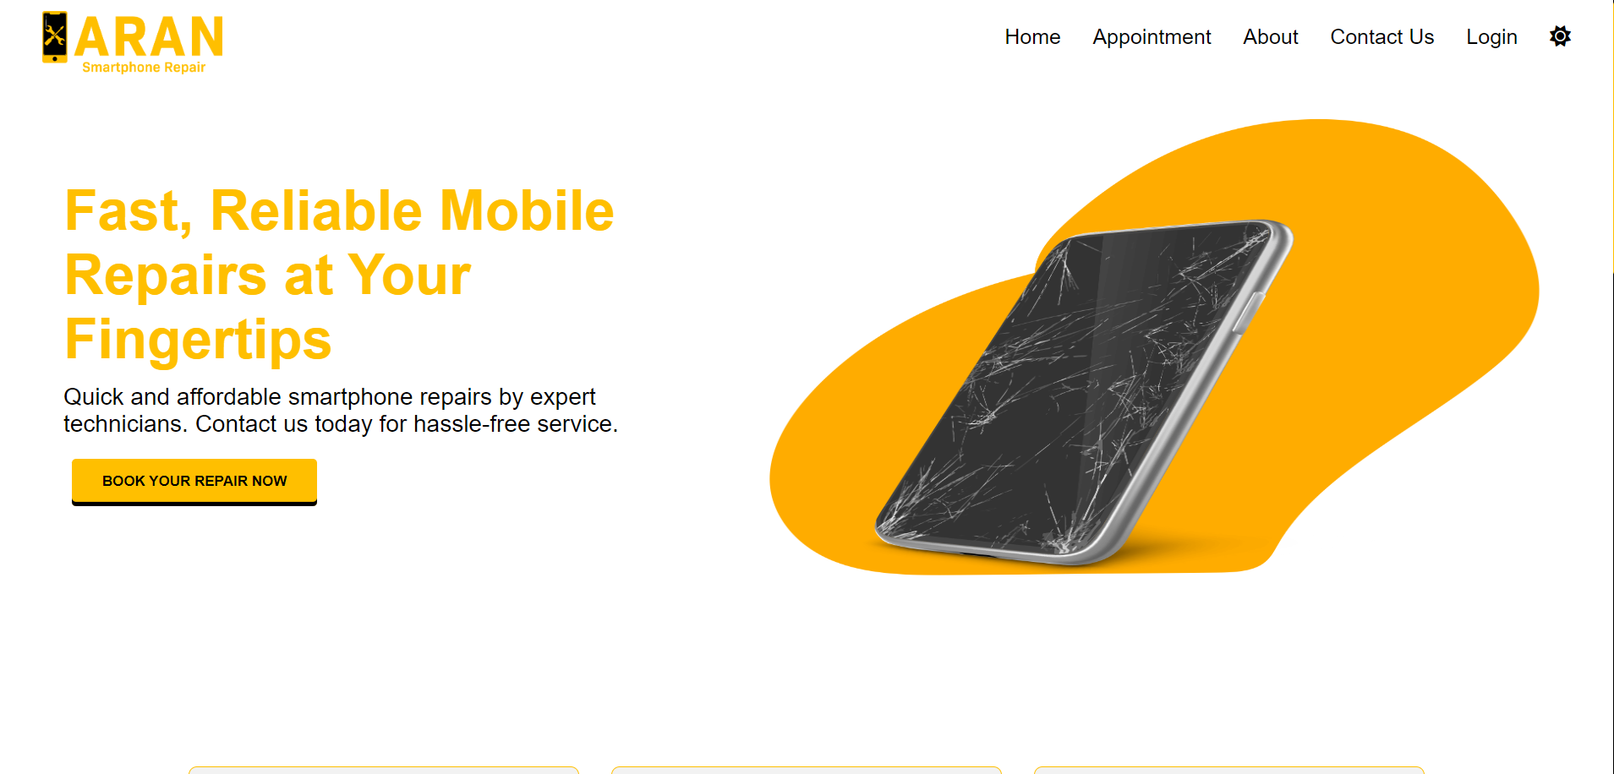
White Hero Section

Slide 6
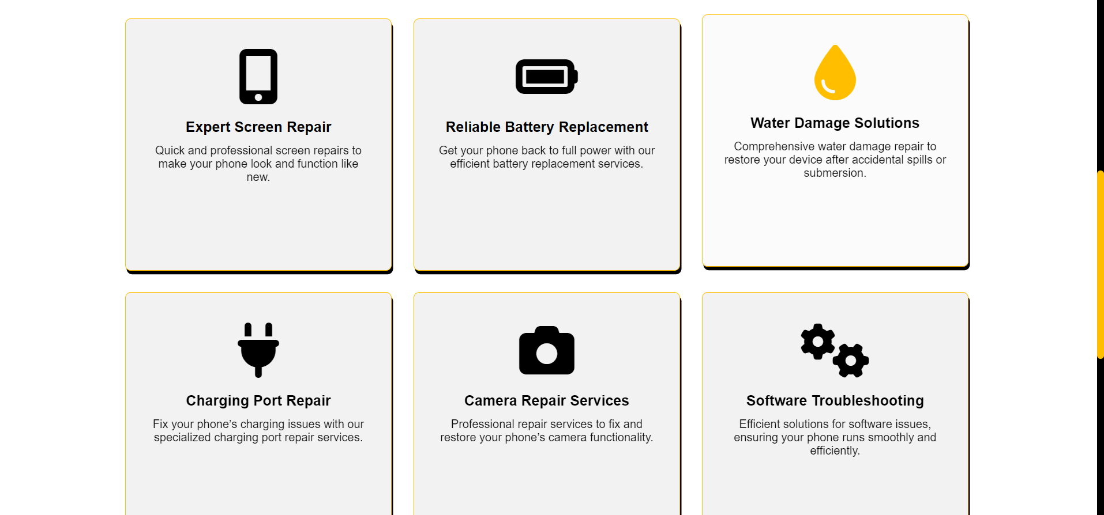
Services

Slide 7
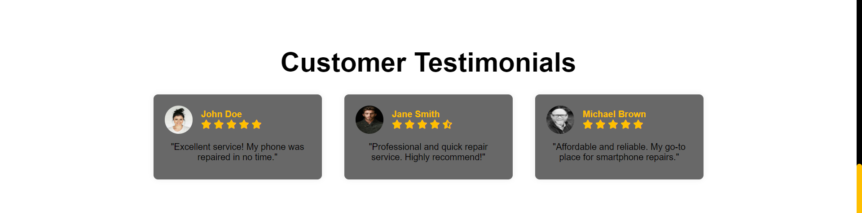
Customer Testamonial

Slide 8
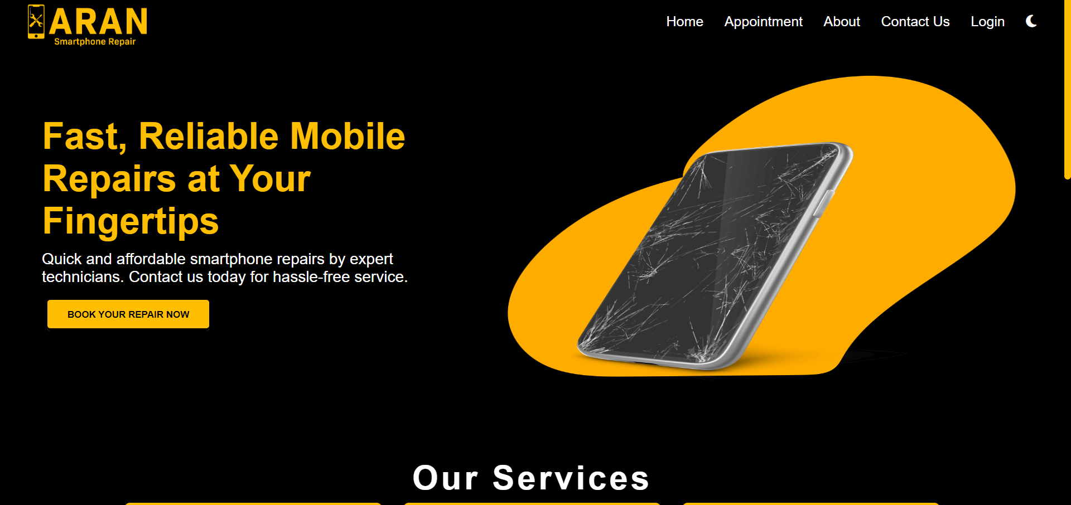
Dark Mode

Slide 9
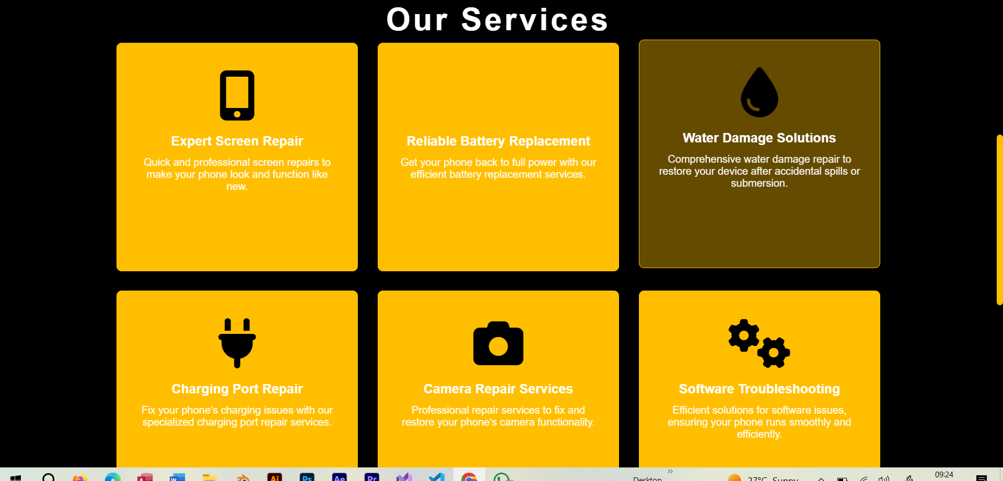
Dark Mode

Slide 10
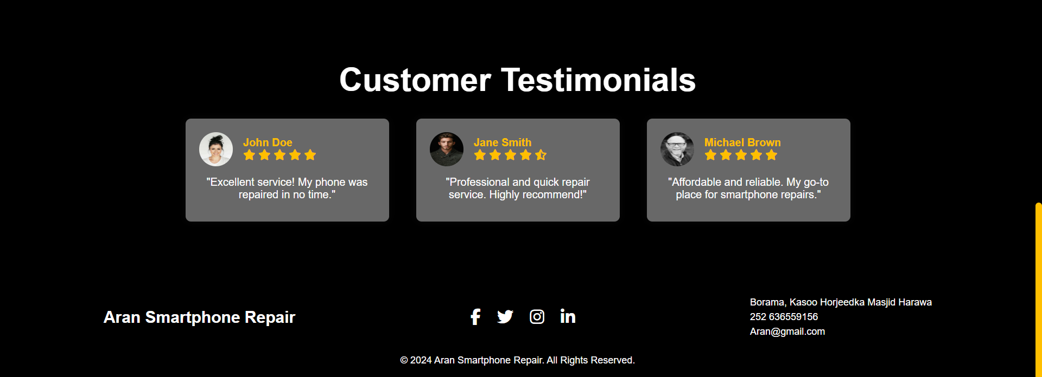
Dark Mode

Slide 11
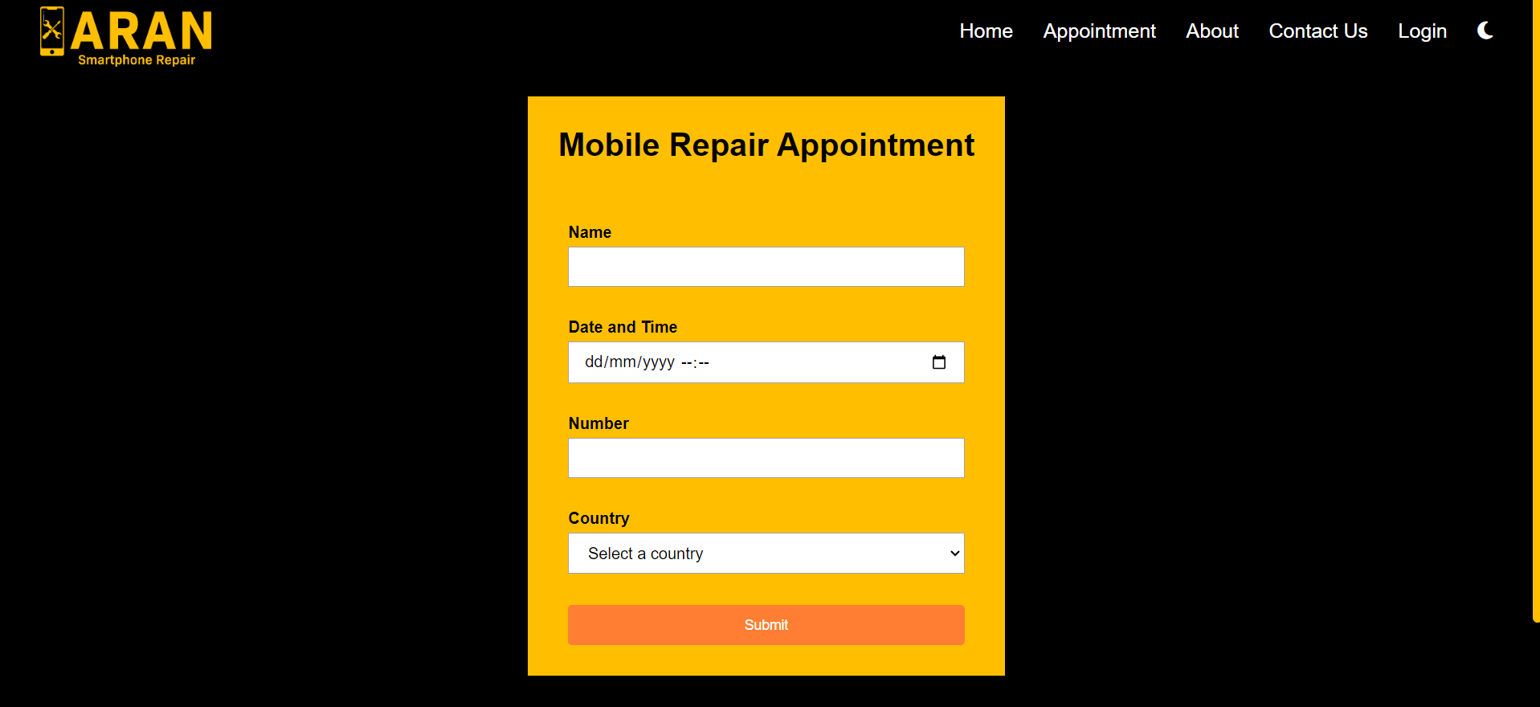
Dark Mode

Slide 12
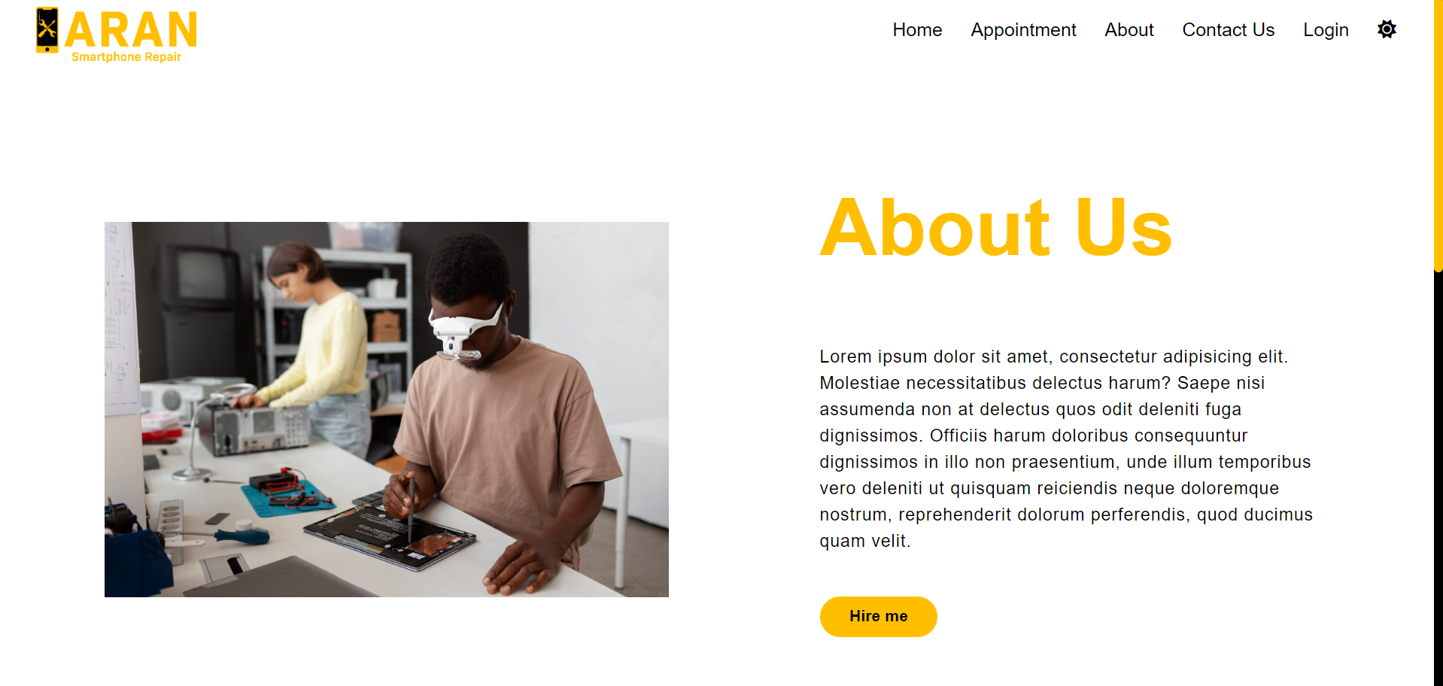
Dark Mode

Slide 13
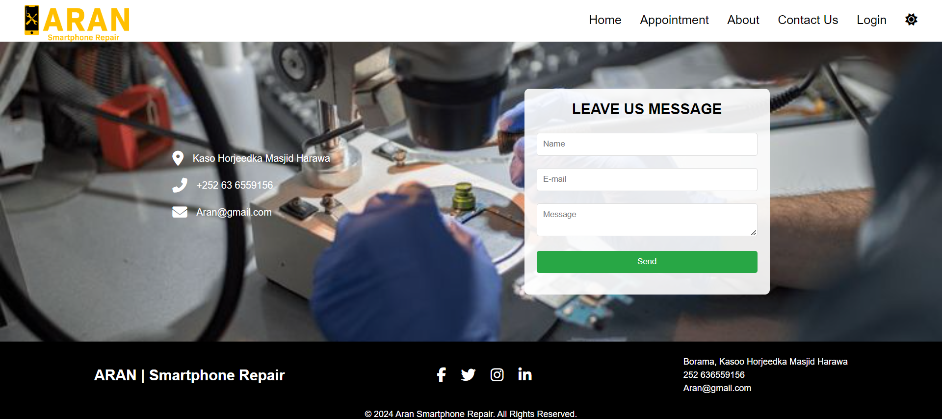
Dark Mode

Slide 14
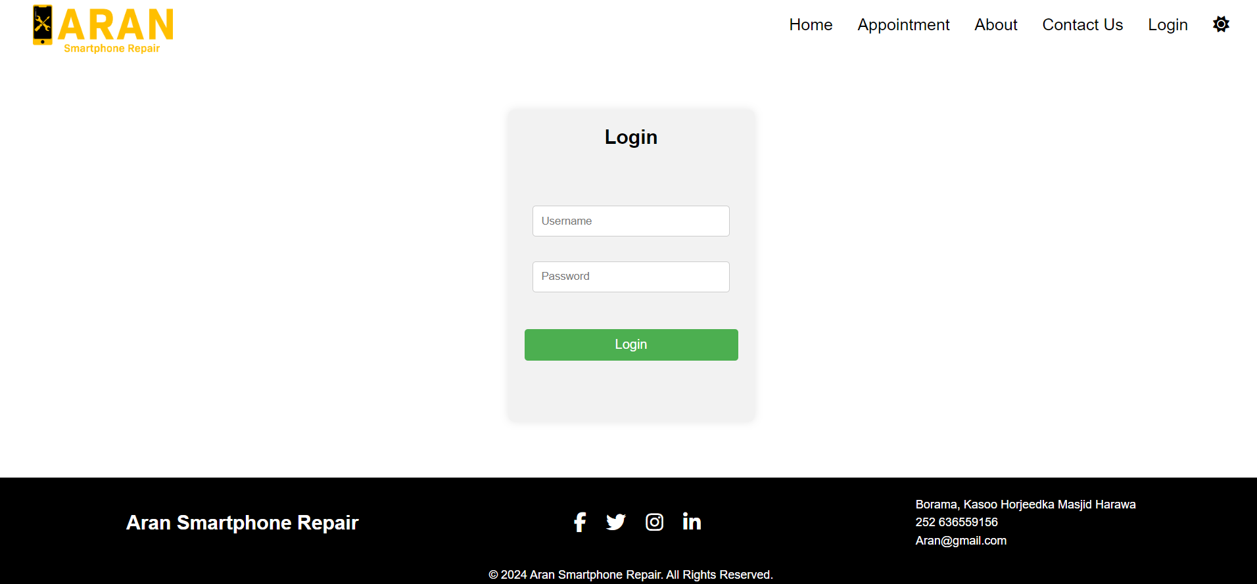
Dark Mode

Slide 15
THE END

